Slide 1


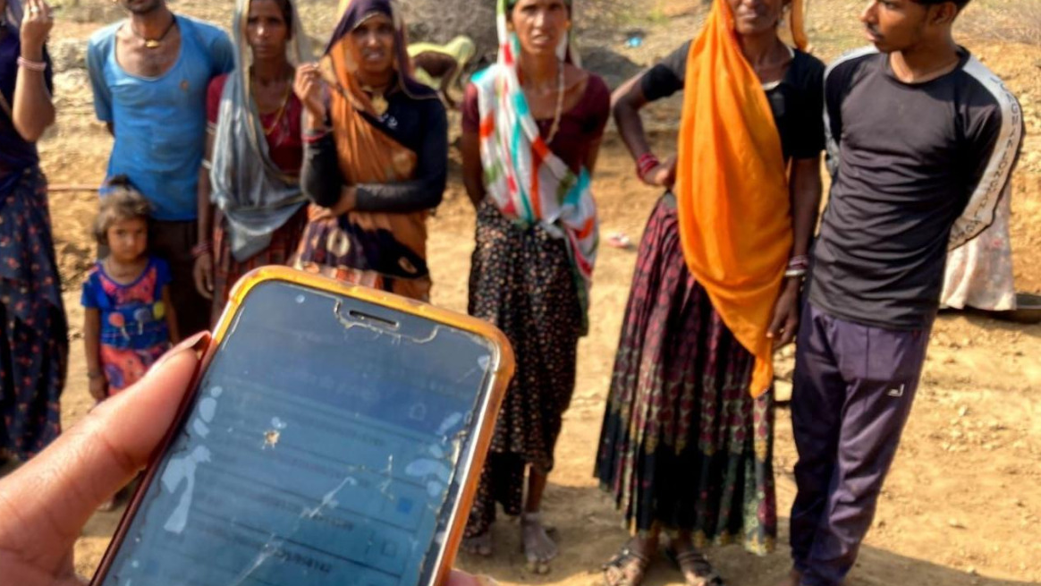

SYSTEM TO detect FACES FROM A GROUP PHOTO for automatic attendance
Gunda nithin(1602-20-737-149)
Harshith kumar(1602-20-737-135)
Santhosh reddy(1602-20-737-313)

Slide 2
Agenda
Refined problem statement
Abstract
Refined motivation
Use cases
Architecture and design

Slide 3
Problem statement
Attendance taking at the rural areas takes lot of worktime for the people working there. When the attendance is taken manually it takes a lot of time for the attendance marker . A System may be developed using automatic analysis for the uploaded image or image taken via camera and detect and match the faces for automatic attendance in the system so that this problem of taking attendance manually may be completely resolved.

Slide 4
Abstract
Do you know who are MGNREGA workers and how much time it takes for attendance of MGNREGA labourers rural areas? When the attendance is taken manually it actually consuming a lot of time, as it is having very less hours. Basically our tool when given an image containing group of workers, it will detect, separate and match the workers and mark them for their attendance by using Face Recognition Mechanism. We are going to develop an Web-based System which classifies the image uploaded by user .

Slide 5
MOTIVATION
To ensure more transparency, accountability, efficiency and monitoring, and then weed out corruptions where the worksites are been managed even though workers are not there and funds are been misused and improper implementation, duplication of work been doing for quite some time.
We can also reduce the burden for attenders and workers in rural area for attendance by simplifying the process.

Slide 6
USE CASE DESCRIPTION
USE CASE 01:
NAME: attender login
ACTOR: attender
DESCRIPTION: checking the attender login validation to upload document.
PRE-CONDITIONS: attender should have an id and password given by programme officer
USER | SYSTEM
1.Enter username and password
2.Click login
 | 3.Verify login credentials.
 | 4.Take to next page, if login details are correct or else enter login details again.

Slide 7
USE CASE 02:
NAME: Uploading the group image
ACTORS: attender
DESCRIPTION: add the image taken
PRE-CONDITIONS: file should be in JPG or JPEG format
POST-CONDITIONS: click next button
USER | SYSTEM
 | 1.Display the fields for uploading the image
2.Upload the photo in field specified
3.Click on next button

Slide 8
USE CASE 03:
NAME: Checking the quality of the uploaded image
ACTORS: attender
DESCRIPTION: verify the image taken
PRE-CONDITIONS: image should maintain clarity faces of the people present
POST-CONDITIONS: click next button
USER | SYSTEM
 | 1.Display the field for uploading the image.
2.Upload the image that is taken.
3. Click on next button.
 | 4.Displays the image taken on the field and checks the faces clarity.

Slide 9
USE CASE 04:
NAME: Recognising the faces from the dataset
ACTOR: system
DESCRIPTION: Checking the dataset images and the detected faces
PRE-CONDITIONS: Images should be uploaded.
POST-CONDITIONS: the faces detected should be having its probability greater than 0.5.
USER | SYSTEM
 | 1.Check the quality of the images.
 | 2.If they are good enough then move to next step.
 | 3.Else a message will be given to user to re-upload another image.

Slide 10
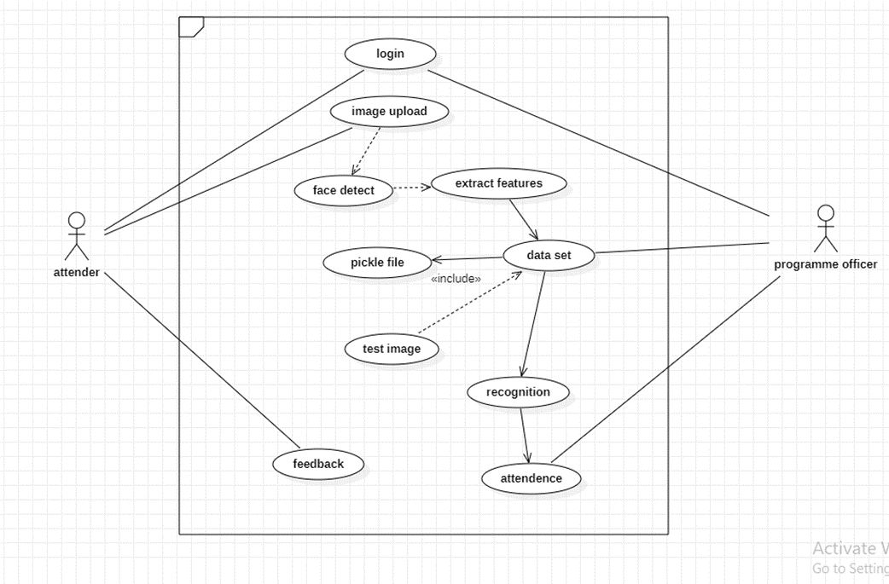
USE-CASE DIAGRAM
c

Slide 11
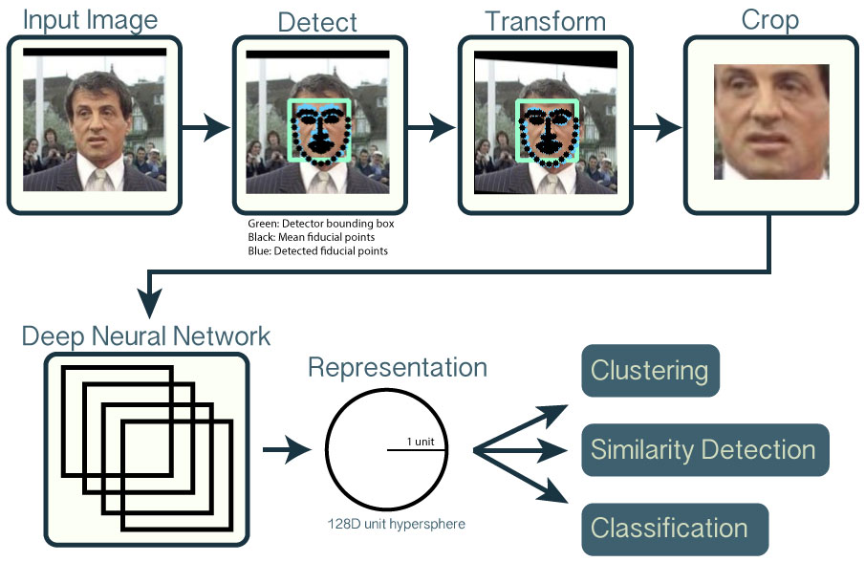
training
Our purpose is to make a facial recognition system which needs as less training data as possible. The main reason behind this constraint is the fact that it is more useful for a supervisor to have train the model with one or few pictures for each person rather than having to make a large Dataset with many images for the same person. So, we will be using DNN(deep neural network) algorithm to detect faces and represent the extracted embeddings into 128D hypersphere.

Slide 12
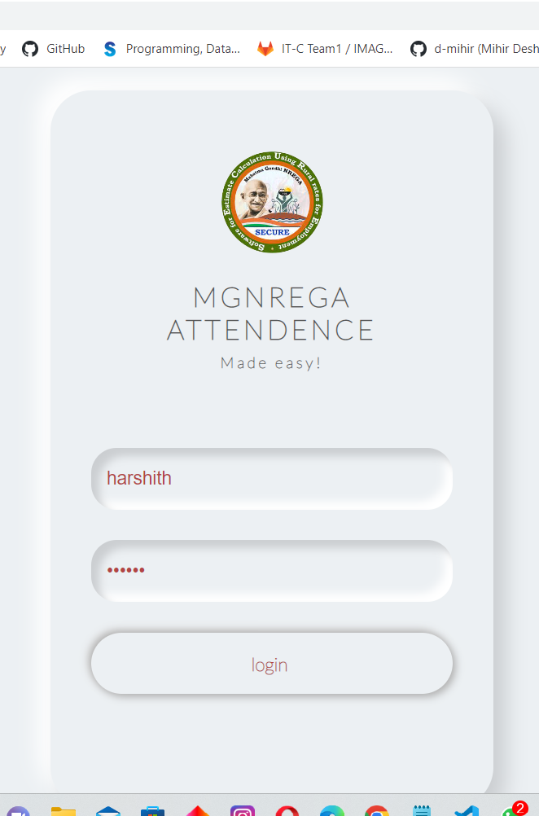
RESULT: LOGIN PAGE

Slide 13
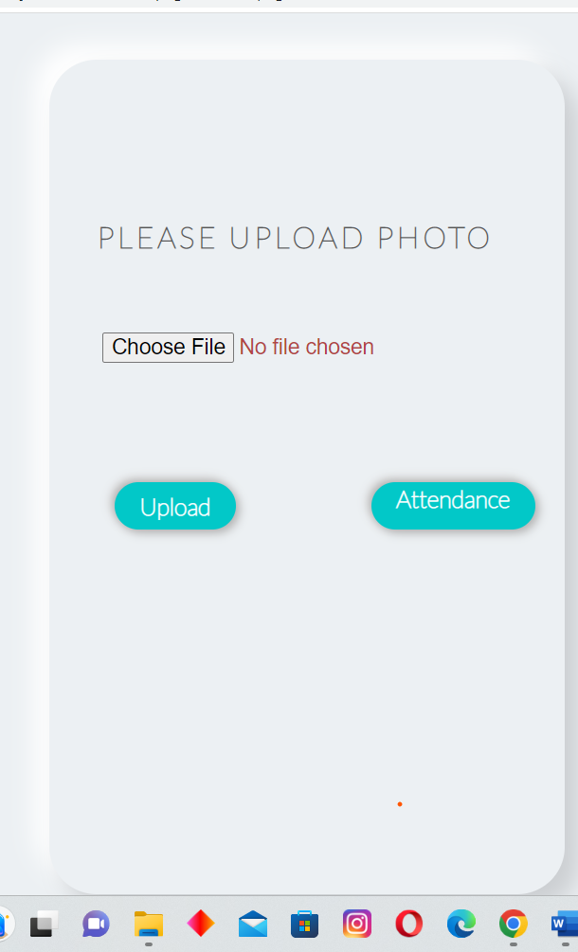
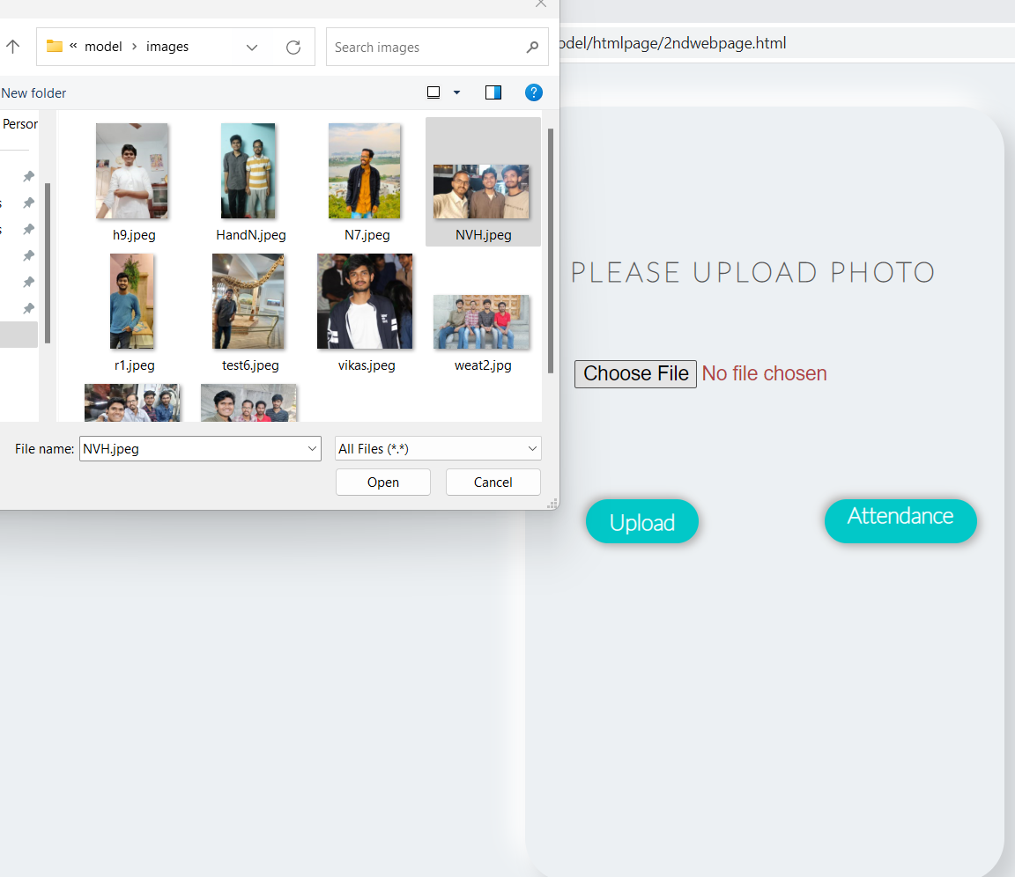
RESULT: UPLOAD page

Slide 14
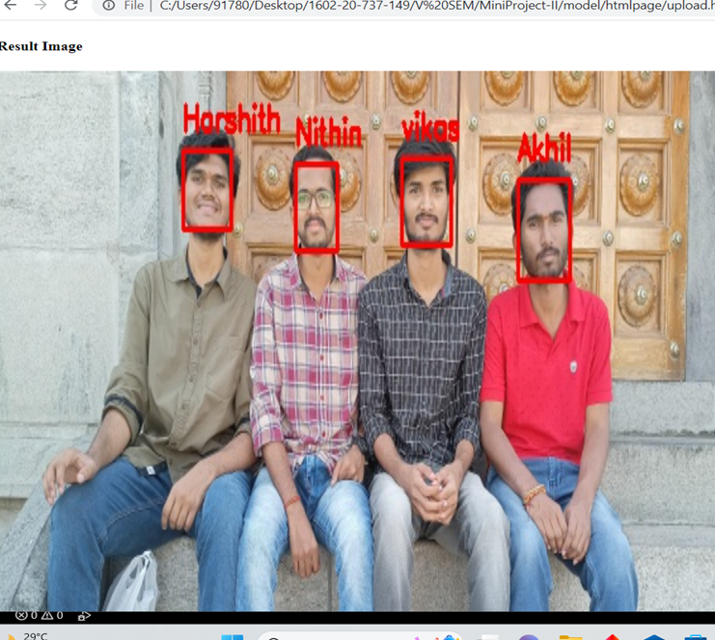
RESULT: face recognition

Slide 15
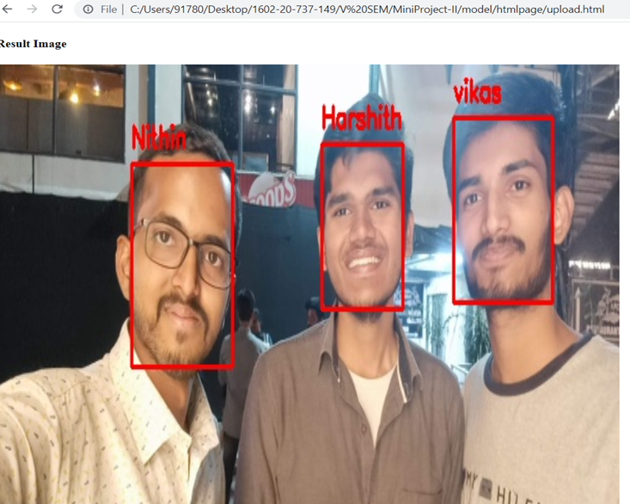
RESULT: face recognition

Slide 16
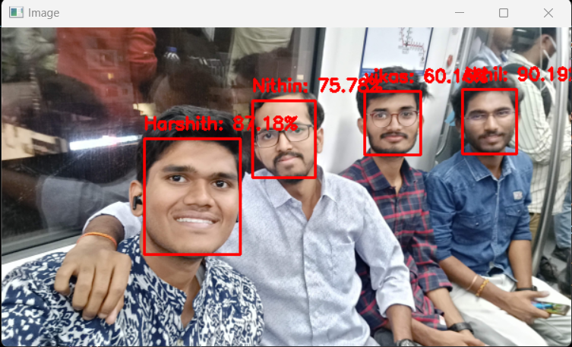
RESULT: face recognition

Slide 17
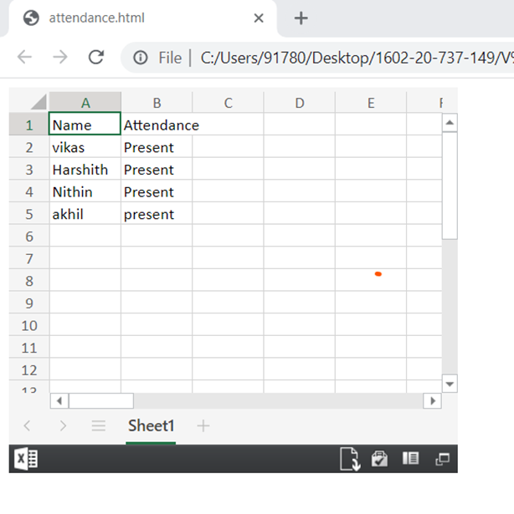
RESULT: attendence

Slide 18
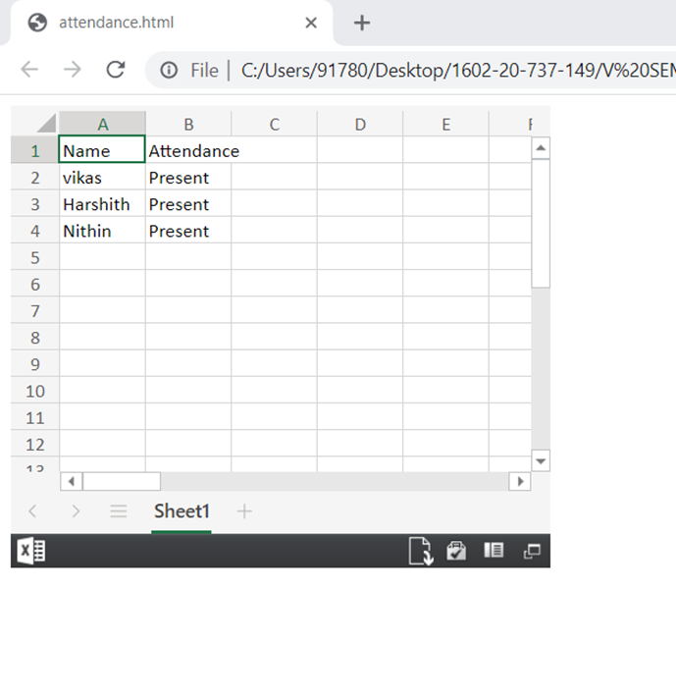
RESULT: attendence

Slide 19
Hardware and Software Requirements
Hardware requirements –
Intel core i5 processor
1 GB RAM
Software requirements –
Python 3.9
Xlsx workbook
VS Code IDE
OpenCV

Slide 20
Technology used :
Front end:-- HTML,CSS
Libraries:-- OpenCV, sklearn, DNN
Language used:-- python
IDE:--- VS Code

Slide 21
REFERENCES
https://nrega.nic.in/Nregahome/MGNREGA_new/Nrega_home.aspx
https://pyimagesearch.com/2018/02/26/face-detection-with-opencv-and-deep-learning/
https://rural.nic.in
https://pyimagesearch.com/2017/08/21/deep-learning-with-opencv/

Slide 22
THANK YOU..

